Slide 1
Engineering Mechanics
By:- Dr. Shruti Shukla
Assistant prof.
Civil Engineering Department

Slide 2
3-0-2 (3+1 credits)
3 credit for Theory
1 credit for Lab Work

Slide 3
Theory :
Monday :8.30 am to 9.20 pm
Wednesday: 11.30 am to 12.20 pm
Thursday : 10.30 am to 11.20 am
Practical :
Batch-1 Monday: 2.00 pm to 3.50 pm
Batch-2 Friday:4.00 pm to 5.50 pm

Slide 4
Theory = 100 marks
Mid Sem Exam= 30 marks
End Sem Exam = 50 marks
Class test = 10 marks (before Mid sem exam)
Class test = 10 marks (before End sem exam)

Slide 5
COURSE GOALS
To introduce the theory and concepts that describe how rigid bodies behave when subject to forces
To introduce basic concepts of Engineering Mechanics
To allow application of these ideas for analysis of structures
To use this knowledge to design new structures

Slide 6
Course Objectives
Upon successful completion of this course, students should be able to:
(i) Understand law of Mechanics, Newton’s law and fundamental of Statics.
(ii) Understand and solve simple problems involving forces in plane and forces in Space.
(iii) Understand the space diagram and free body diagrams and solve problems.
(iv) Apply sound analytical techniques and logical procedures in the solution of engineering problems.

Slide 7
Introduction/forces/equilibrium of rigid body
Centroid, Moment of inertia
Truss
Beams and cables
Friction
Kinetics of particles
Vibrations

Slide 8
1) Introduction/forces/equilibrium of rigid body
Scalar and vector, system of forces, resultant force
Statics of particle. Free-body diagram. Equilibrium of particle in two dimensions.
Resultant of three or more concurrent forces, Resolution of a force into components.

Slide 9
Concurrent forces:
Non concurrent forces:
Coplanar forces:
Non Coplanar forces:
Non-coplanar concurrent forces
Collinear forces

Slide 10
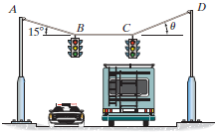

Slide 11


Slide 12
1) Introduction/forces/equilibrium of rigid body
Rectangular components of a force. Resultant by rectangular components.
Concurrent force system in space: Resolution of a force into rectangular components in space.
Coplanar Non-Concurrent Force Systems, Moments about Point and Axis. Equilibrium of Non-coplanar Non-concurrent Forces

Slide 13
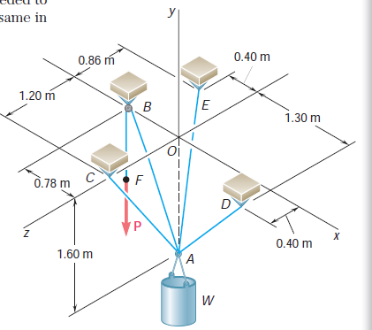

Slide 14
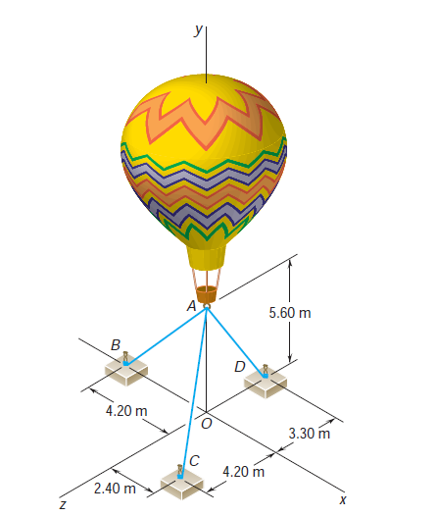

Slide 15
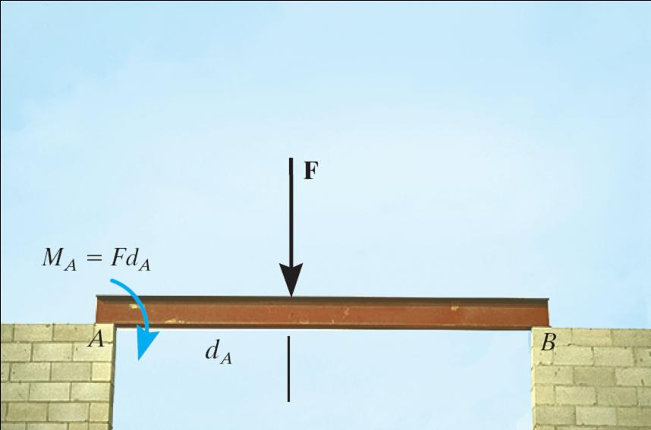

Slide 16
2) Centroid, Moment of inertia
Distributed forces: Centroid and center of gravity. Determination of centroid of lines and areas using integral technique.
Determination of centroid of composite wires and areas.
Centroid of volumes. Theorems of Pappus - Guldinus and its applications.
Second moment of areas. Definition of moment of inertia. Determination of moment of area by integration.
Parallel axis theorem for Moment of Inertia. MI of composite area. Concept of Mass moment of inertia of body.

Slide 17
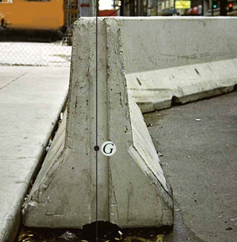

Slide 18
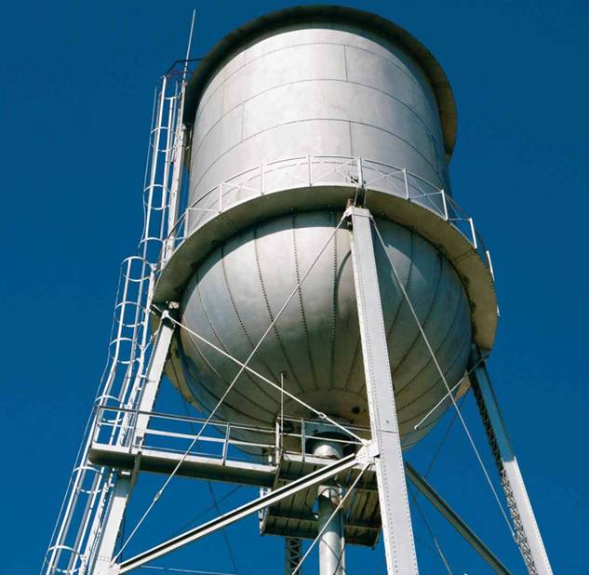
APPLICATIONS
To design the structure for supporting a water tank, we will need to know the weights of the tank and water as well as the locations where the resultant forces representing these distributed loads act.
How can we determine these weights and their locations?

Slide 19
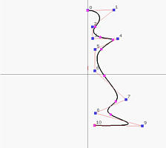
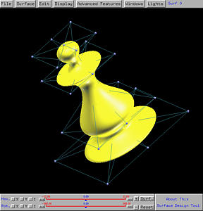

Slide 20
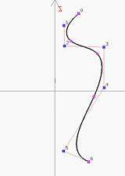
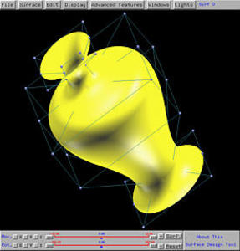

Slide 21
3) Beams and Cables
Beams
Definitions, types of beam, types of loading, types of support. Determination of reactions for simply supported and over hanging beams
Cables
Cables with Concentrated Loads

Slide 22
W₁
90◦
A
B

Slide 23
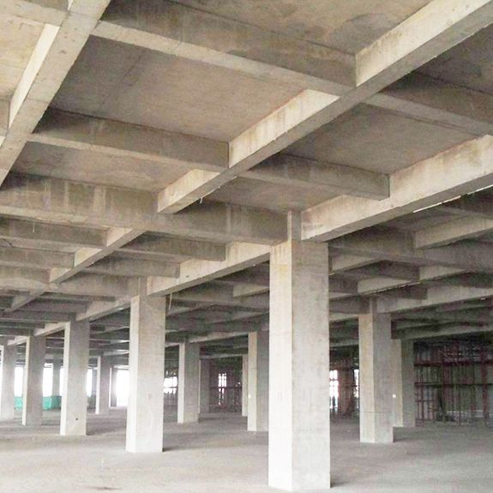
beam

Slide 24
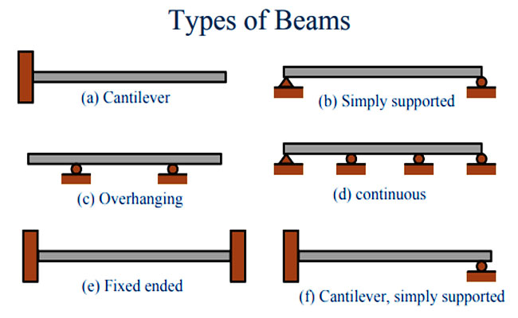
Propped Cantilever

Slide 25
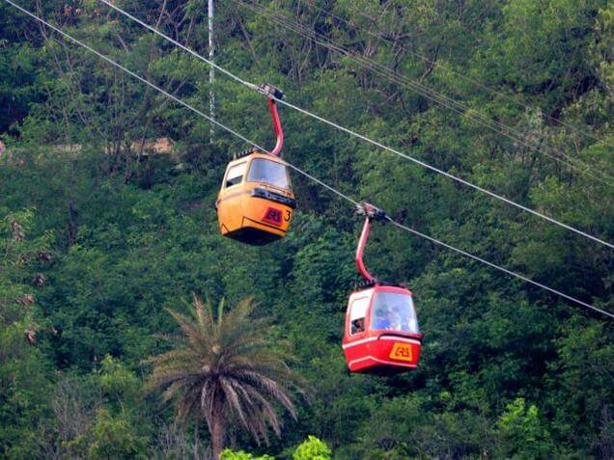

Slide 26
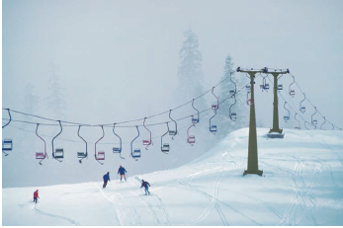

Slide 27

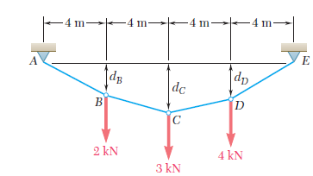
V_{E} =5 kN, H_{E} = 8 kN, F_{CD} = 9.43 kN

Slide 28
4) Truss
Types of structure in Engineering. Trusses and beams: definition, stability and determinacy.
Determination of reactions at supports for planar trusses. Basic assumption for analysis of trusses. Procedures for analysis of trusses.
Analysis of plane trusses by method of joint. Concept of zero force member. Analysis of plane trusses by method of section.

Slide 29
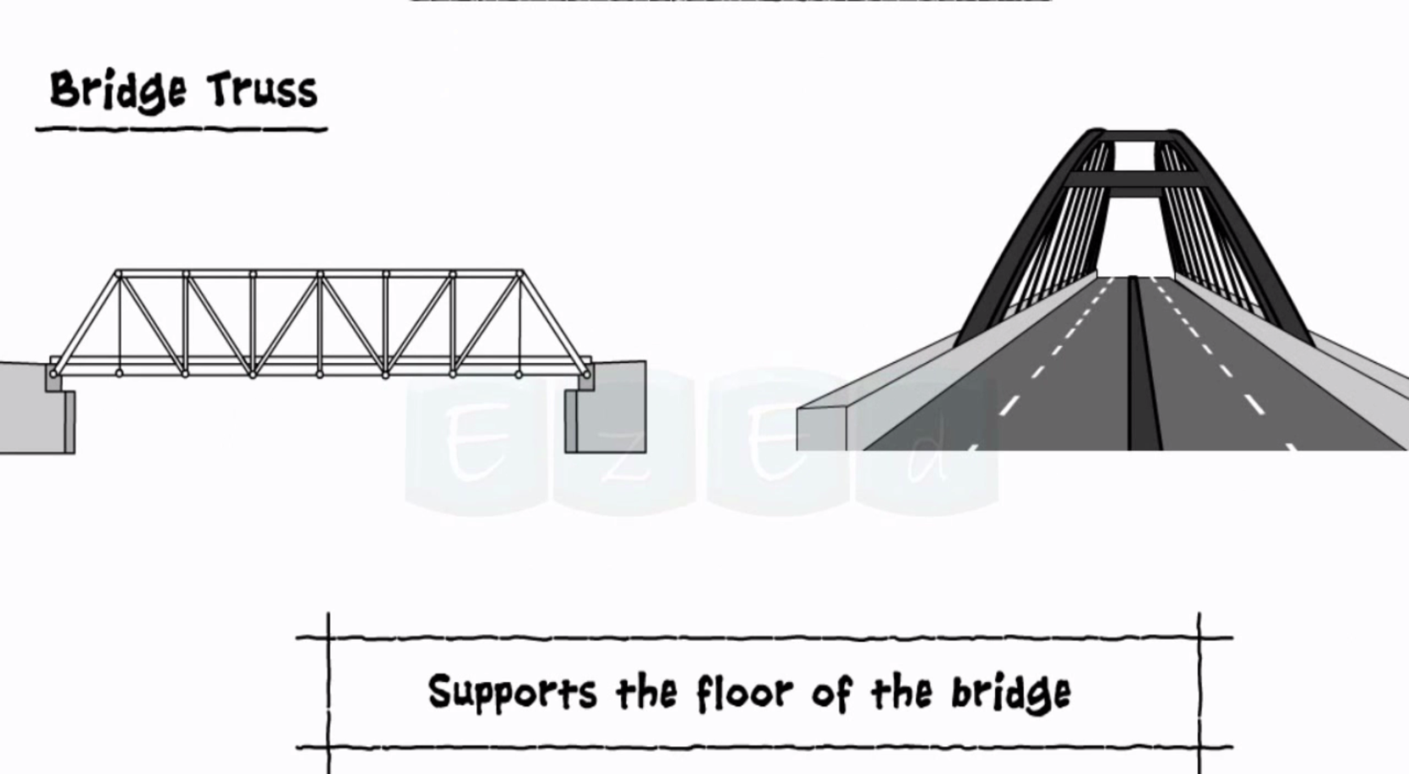

Slide 32
5) Friction
The Law of Dry Friction. Coefficient of Friction, Angle of Friction.
Analysis of systems involving dry frictions such as ladder spheres etc.
Belt Friction, Analysis of flat belt, wedge friction.

Slide 33
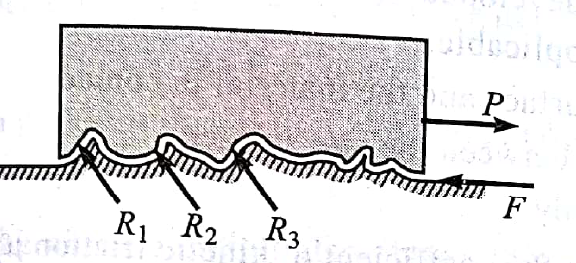
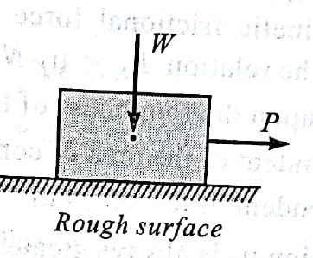
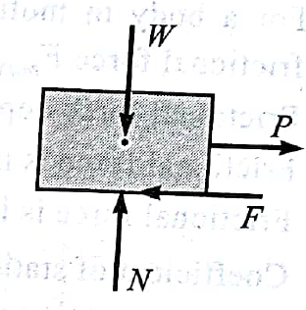
Mechanism of Friction

Slide 34
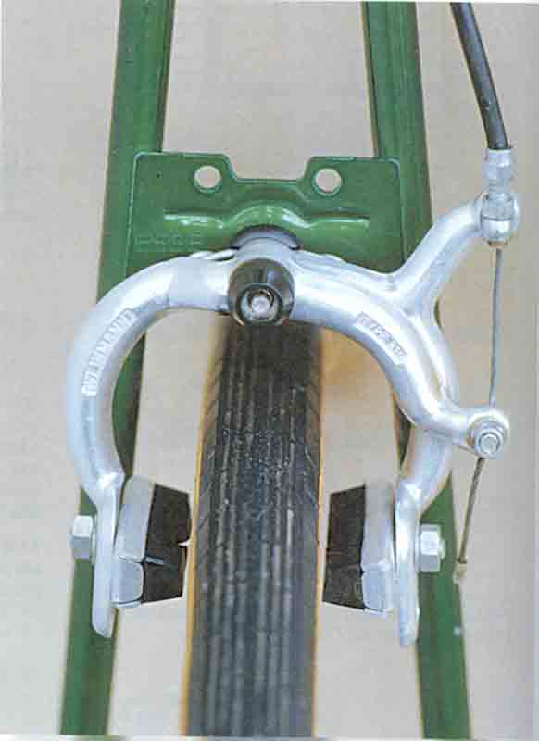
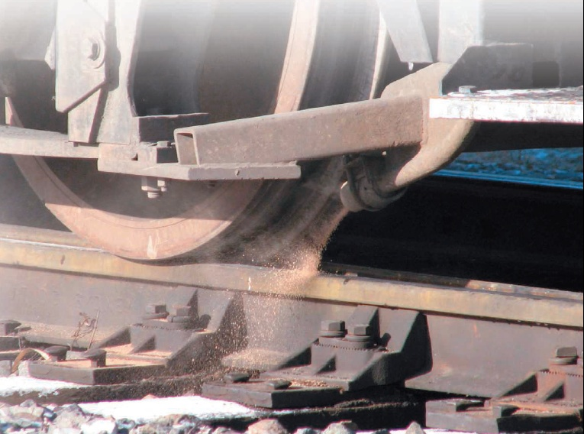
APPLICATIONS
In designing a brake system for a bicycle, car, or any other vehicle, it is important to understand the frictional forces involved.

Slide 35
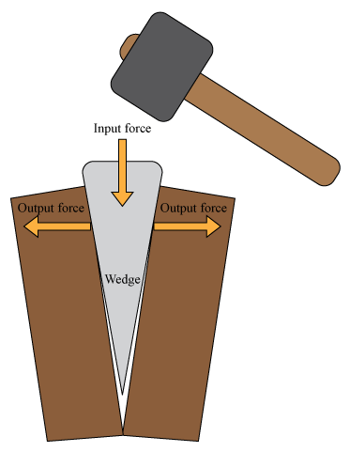
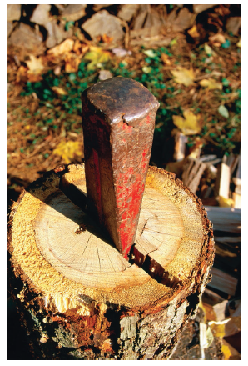
Wedge Friction
Wedges are used as shown to split tree trunks because the normal forces exerted by a wedge on the wood are much larger than the force required to insert the wedge.

Slide 36
6) Kinetics of Particles
Force and acceleration. Newton's laws of motion. D'Alembert's principle.
Dependent motion of particles. Analysis for dependent motion of particles.
Impulse and Momentum : Concept, Definition, Principle of linear momentum and impulse
Work Energy Principle.

Slide 37
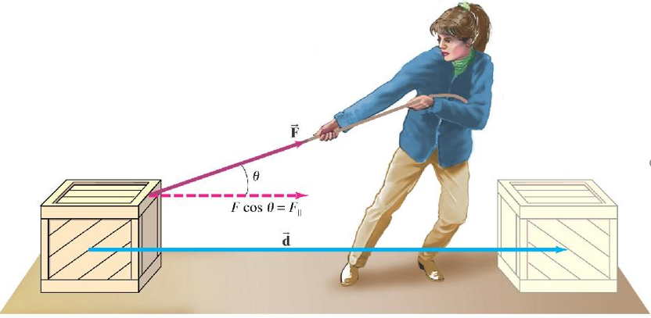
Work
Specifically, a force F will do work on a particle only when the particle undergoes a displacement in the direction of the force.
Notes:
In this chapter, the focus is on the particles. That is the body whose physical dimensions are so small compared with the radius of curvature of its path.
There are at least 3 approaches to the solution of kinetic problems: (a) Newton’s second law (b) work and energy method (c) impulse and momentum method.

Slide 38
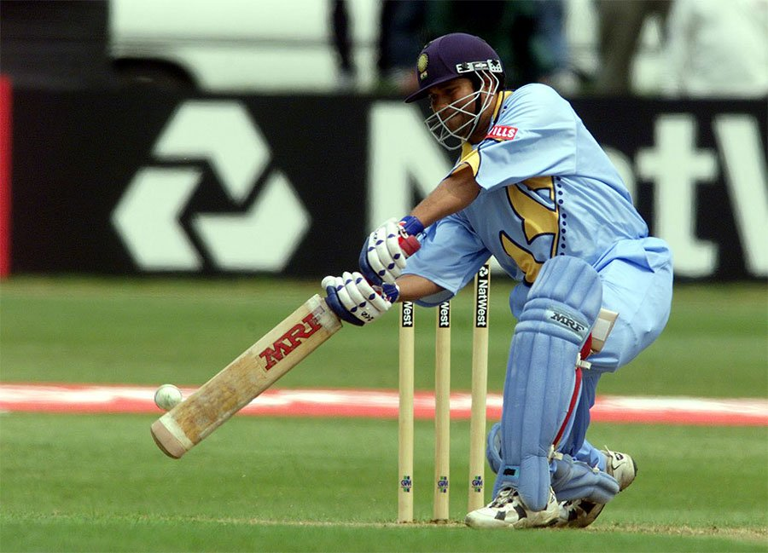
A good example of impulse is the action of hitting a ball with a bat.
The impulse is the average force exerted by the bat multiplied by the time the bat and ball are in contact.

Slide 39
7) Vibrations
Definitions, Equation of motion for single degree of freedom.
Introduction to free and forced vibrations.
Procedure for analysis of system involving free and forced vibrations.
Example on free vibration.
Example on forced vibration.

Slide 40
Books…
Beer, F.P. and Johnston, E.R. “Vector mechanics for engineers: Statics and Dynamics”, Tata McGraw-Hill, New Delhi
Meriam, J.L. and Kraige, L.G. “Engineering Mechanics: Statics and Dynamics”, John Wiley and sons, New York
Rajsekaran, s. “Engineering Mechanics: Statics and Dynamics”, Vikas Publication, New Delhi

Slide 41
Desai, J.A. and Mistry, B.B. “Engineerin Mechanics: Statics and Dynamics”, Popular Prakashan, Surat
Bhavikatti S. S. and Rajashekarappa K.G., Engineering Mechanics, Wiley Eastern Ltd
Hibbeler, R.C. Engineering Mechanics: Statics and Dynamics, Prentice Hall of India, New Delhi

Slide 42
MECHANICS
“that science which describes and predicts the condition of rest or motion of bodies under the application of forces.”
Deals with effect of forces on objects
Mechanics is the physical science, since it deals with physical phenomenon.

Slide 43
Mechanics principles used in vibration, spacecraft design, fluid flow, electrical, mechanical m/c design etc.

Slide 44
Engineering mechanics is the application of mechanics to solve problems involving common engineering elements.
The goal of this Engineering Mechanics course is to expose students to problems in mechanics as applied to real-world scenarios.
..it develops the thinking and imaginative skill of students.

Slide 45
Classic Mechanics (Newtonian Mechanics)
Relativistic Mechanics
Albert Einstein proved that Newtonian mechanics fails to explain the behaviour of high speed (speed of light) bodies. He put fourth the theory of Relativistic mechanics.
Quantum Mechanics
Newtonian mechanics fails to explain the behaviour of particles when atomic distances are concerned.

Slide 46
Mechanics
Rigid Body
Deformable Bodies
Fluid Mechanics

Slide 47
Rigid Body
Combination of larger numbers of particles in which all particles remain at fixed distance from one another both before and after applying load.
Material properties (not considered)

Slide 48
Deformable Bodies
Strength of materials
Theory of Elasticity and Plasticity

Slide 49
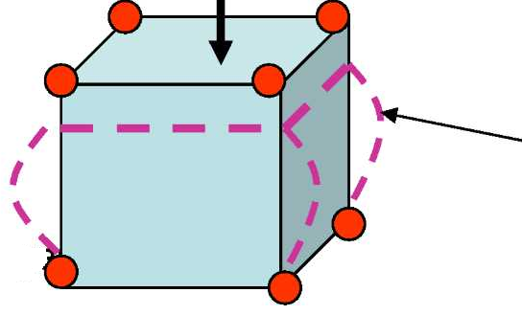

Slide 50
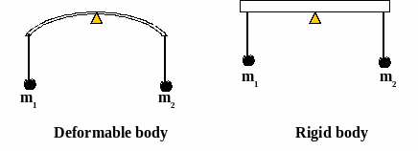

Slide 51
Fluid Mechanics
Deals with liquids and gases
Incompressible fluids (Hydraulics)
Compressible fluids

Slide 52
Statics
Dynamics
Rigid Body

Slide 53
Statics
Deals with bodies at rest condition
Dynamics
Deals with bodies in motion

Slide 55
Dynamics
Kinematics
Kinetics

Slide 56
Kinematics
It describes the motion of bodies (objects) and systems (groups of objects) without consideration of the forces that cause the motion
V= u + at
S = ut + (1/2)at²
?

Slide 57
Kinetics
It concerned with the relationship between the motion of bodies and its causes.
F = ma

Slide 58
Basic quantities used in mechanics
Length
Time
Mass
Force

Slide 59
Idealization of Bodies
Models or Idealizations are used in order to simplify the application of theory.
Particle
Rigid body

Slide 60
Fundamental Principle of Mechanics
Parallelogram law for the addition of forces
Principle of Transmissibility
Newton’s three Fundamental laws
Newton’s law of Gravitation

Slide 61
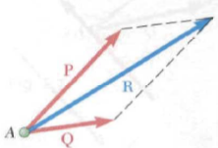
Parallelogram law for the addition of forces

Slide 62
Principle of Transmissibility
A force may be applied at any point on a line of action without changing the resultant effects of the force applied external to rigid body on which it acts.
Magnitude, direction and line of action is important; not point of application

Slide 63
Law I. A particle remains at rest or continues to move with uniform velocity (in a straight line with a constant speed) if there is no unbalanced force acting on it.
Law II. The acceleration of a particle is proportional to the vector sum of forces acting on it, and is in the direction of this vector sum.
Law III. The forces of action and reaction between interacting bodies are equal in magnitude, opposite in direction, and collinear (they lie on the same line).

Slide 64
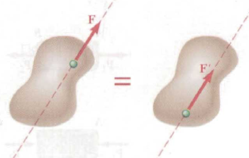
This conclusion is summarized by the principle of transmissibility,
which states that a force may be applied at any point on its given line of
action without altering the resultant effects of the force external to the
rigid body on which it acts.

Slide 65
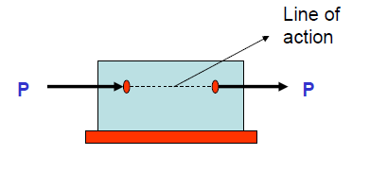

Slide 66
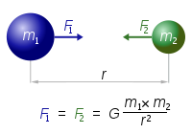
Newton’s law of Gravitation
In statics as well as dynamics we often need to compute the weight
of a body, which is the gravitational force acting on it. This computation
depends on the law of gravitation, which was also formulated by Newton.
The law of gravitation is expressed by the equation

Slide 67
Every point mass attracts every single other point mass by a force pointing along the line intersecting both points.
The force is proportional to the product of the two masses and inversely proportional to the square of the distance between them

Slide 68

SI Units

